Slide 1
ME469: Mesh Motion Approaches
Stefan P. Domino^{1,2}
¹ Computational Thermal and Fluid Mechanics, Sandia National Laboratories
² Institute for Computational and Mathematical Engineering, Stanford
SAND2018-4536 PE

Slide 2
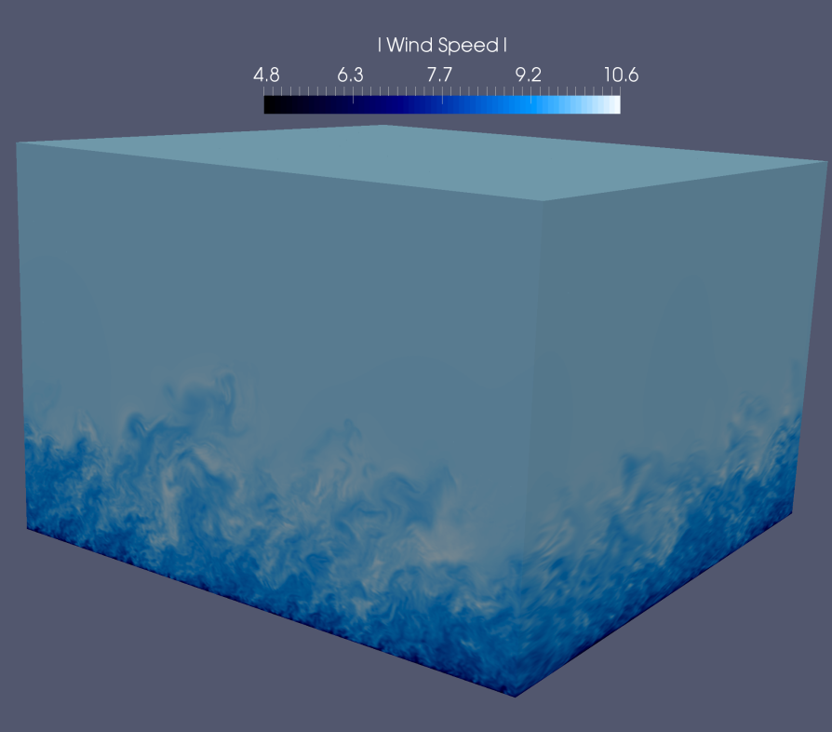
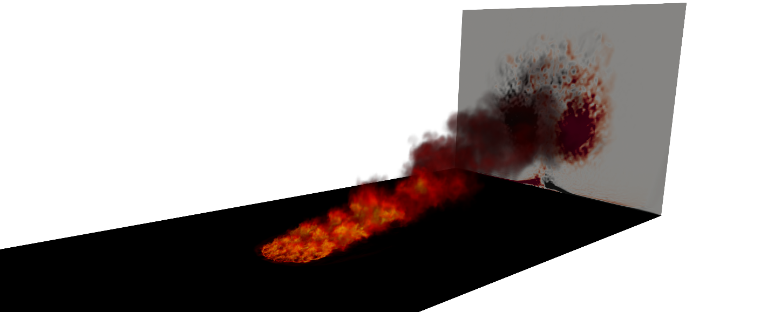
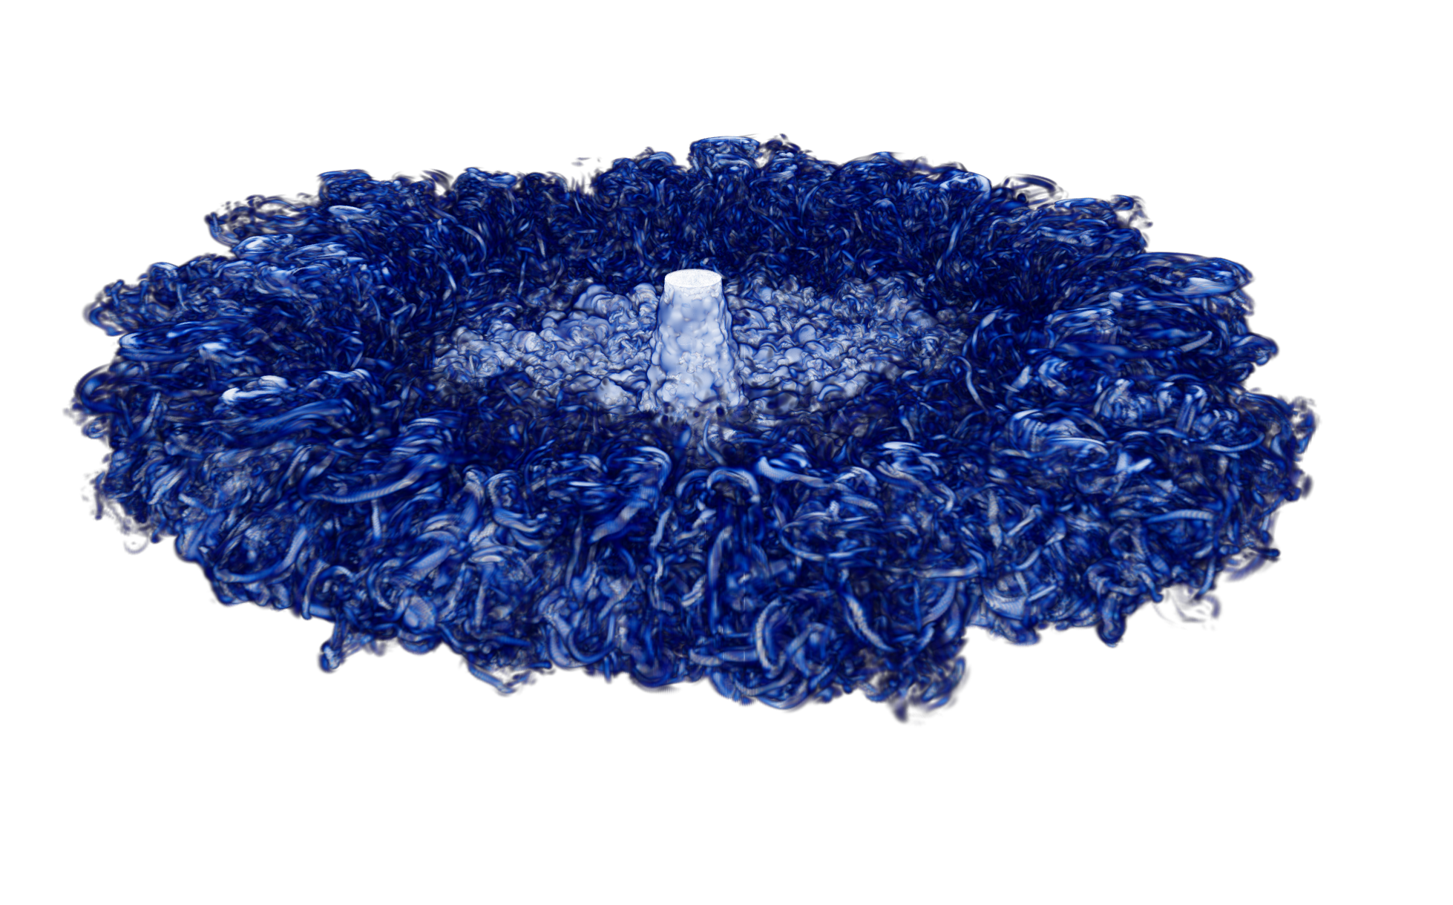
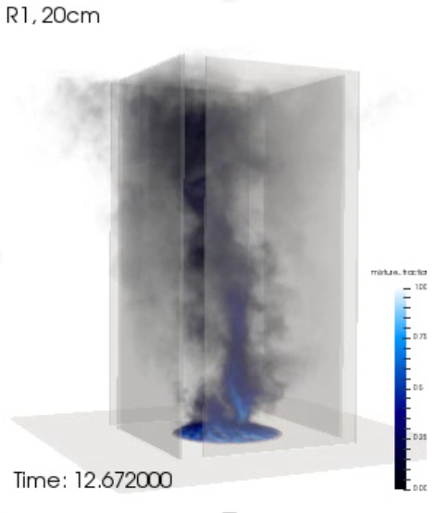
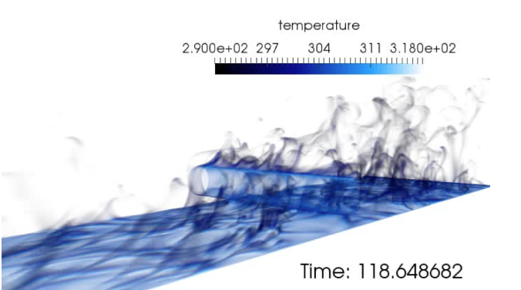
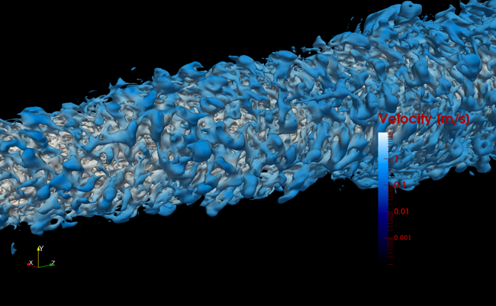
Thus Far, Many Complex Applications: Multi-physics, Static-Mesh

Slide 3

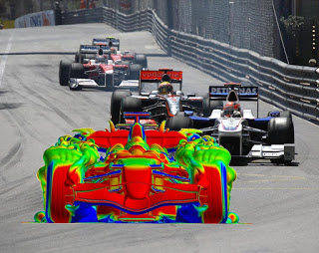
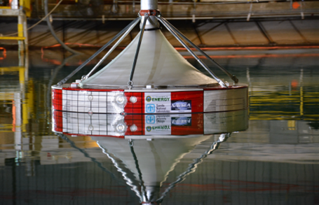
However, Many Applications in Which A Body Moves…..
Wave, Coe et al., SAND2016-10094
Wind, Sandia SWIFT facility,
https://energy.sandia.gov
https://web.stanford.edu/group/frg/

Slide 4
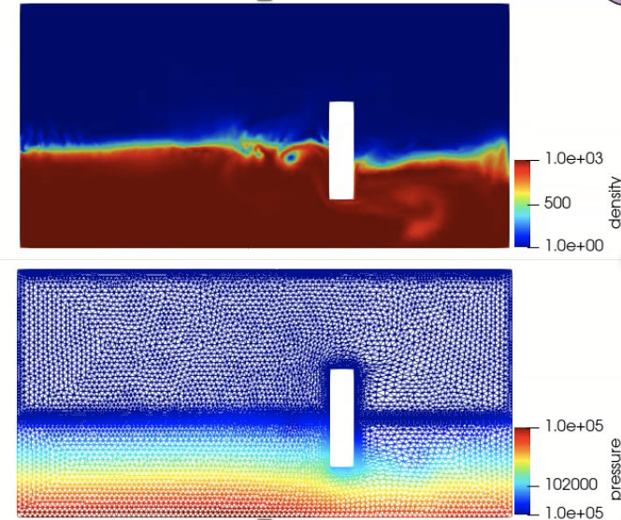
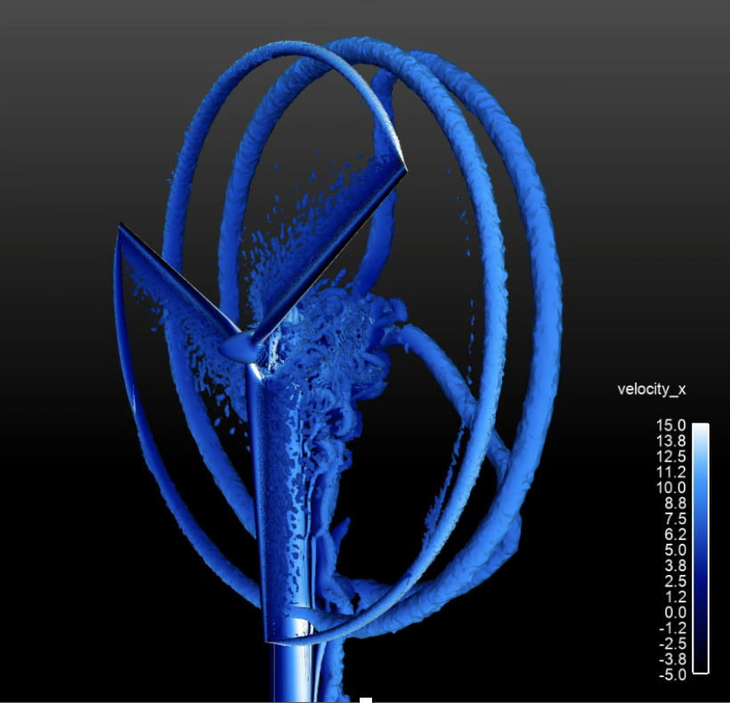
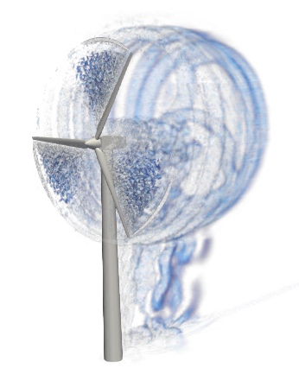
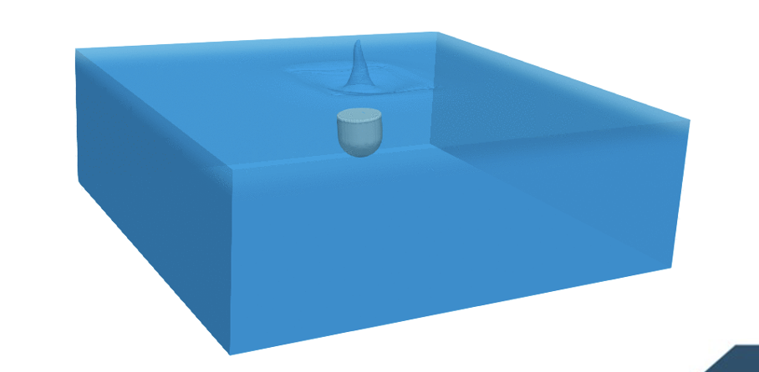
Moving Mesh Approaches
Options: mesh deformation, sliding mesh and overset

Slide 5
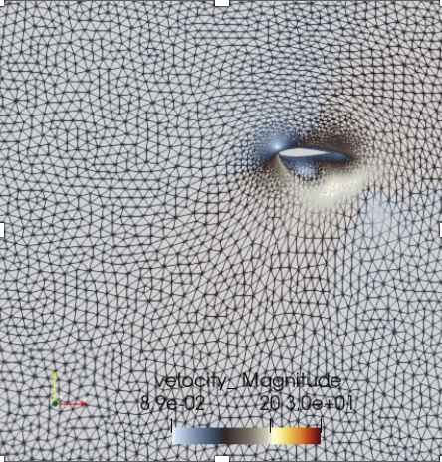
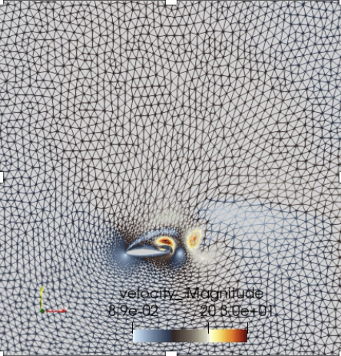
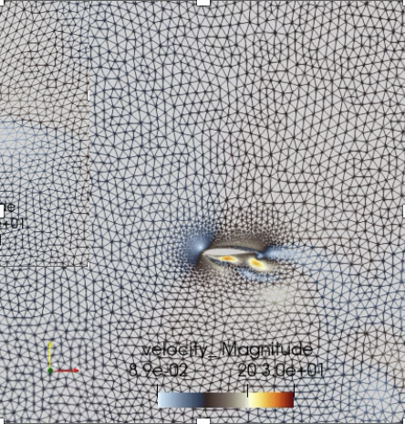
Mesh Deformation and Mesh Smoothing
The mesh remains conformal and distorts (compresses and is stretched) as the solid body moves.
Elements encounter a volumetric time-rate of change
Flow past an erratic airfoil

Slide 6
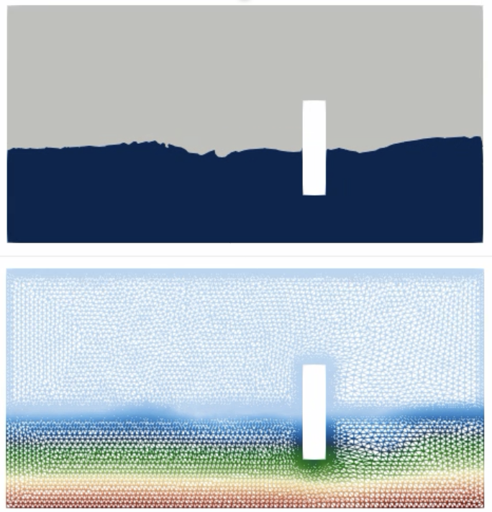
A Note on Fluid/Structure Interaction (FSI)
Info:
density (top; water is blue)
static pressure (bottom)
– roughly ten seconds
FSI drives coupling between the solid body structural response, the fluid mechanics (force and loadings), and the mesh smoothing scheme
Linear Elastic Structural Mechanics
Fluids solve provides static n^{1/2} pressure (surface)
Wave Generator

Slide 7
A Note on Fluid/Structure Interaction (FSI)
Info:
density (top; water is blue)
static pressure (bottom)
– roughly ten seconds
FSI drives coupling between the solid body structural response, the fluid mechanics (force and loadings), and the mesh smoothing scheme
Linear Elastic Structural Mechanics
Mesh Motion Mechanics
Lame’ constants
Fluids solve provides static n^{1/2} pressure (surface)
SM solve provides displacements (surface)
PDE-based where stress is modeled (above elastic) with special properties
Wave Generator

Slide 8
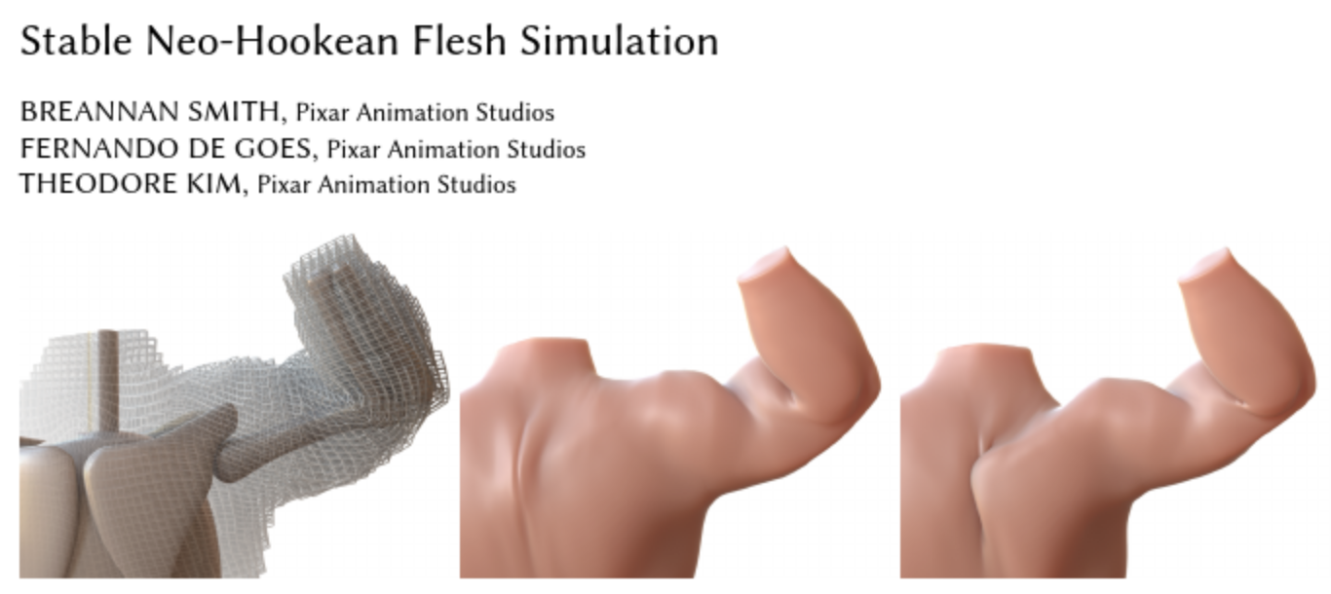
A Note on Fluid/Structure Interaction (FSI)
Info:
density (top; water is blue)
static pressure (bottom)
– roughly ten seconds
FSI drives coupling between the solid body structural response, the fluid mechanics (force and loadings), and the mesh smoothing scheme
Linear Elastic Structural Mechanics
Mesh Motion Mechanics
Lame’ constants
Fluids solve provides static n^{1/2} pressure (surface)
SM solve provides displacements (surface)
Smith et al. “Stable Neo-Hookean Flesh Simulation”, Pixar Animation Studios,
and “spring” approaches that connect opposing vertices of the element
Wave Generator

Slide 9
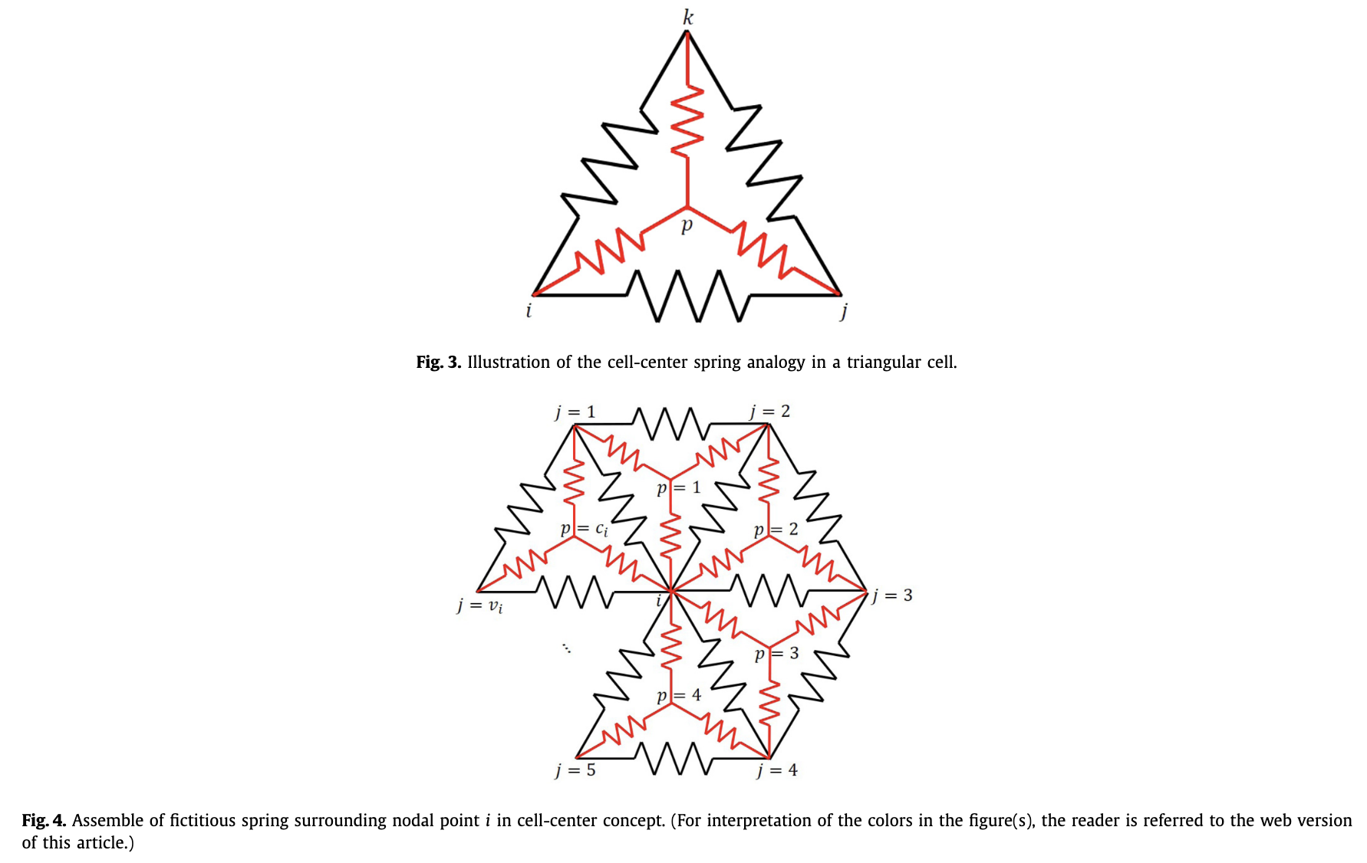
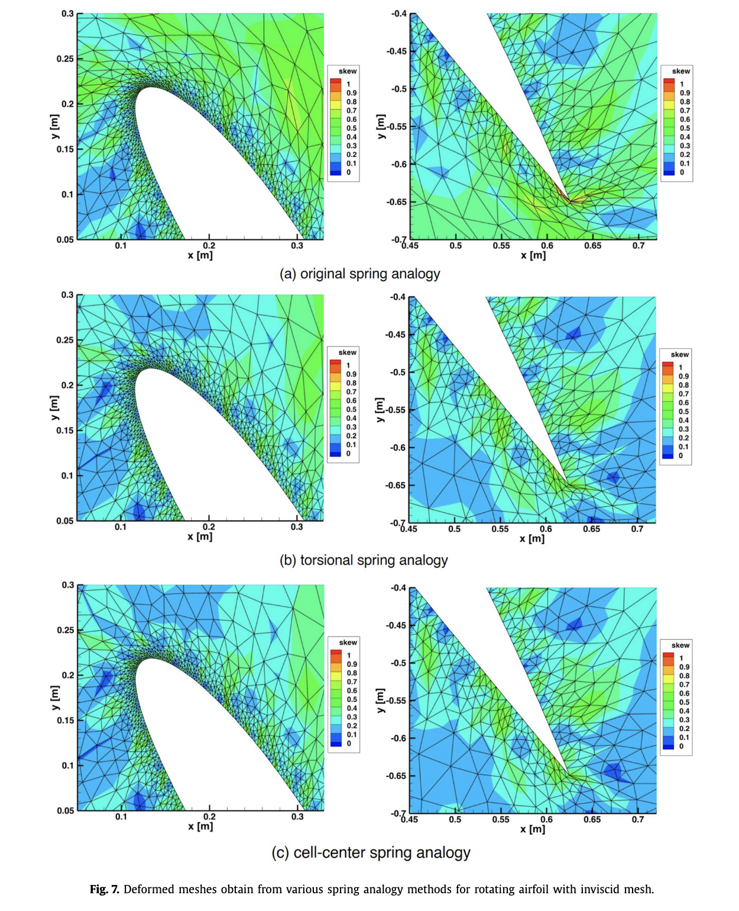
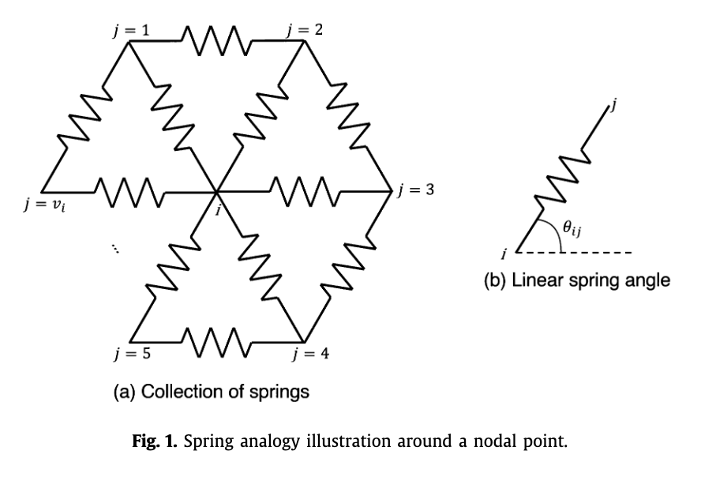
Physical Analogy: Model the mesh by connected springs
Rather than solve a PDE with a modified stress model, the elements can be tied together by “springs”, see Yang et al, “Improvement in the spring analogy mesh deformation method through the cell-center concept”, Aero. Science Tech. (2021)
Physics Analogy (as apposed to PDE-based)

Slide 10
A Note on Fluid/Structure Interaction (FSI)
Info:
density (top; water is blue)
static pressure (bottom)
– roughly ten seconds
FSI drives coupling between the solid body structural response, the fluid mechanics (force and loadings), and the mesh smoothing scheme
Linear Elastic Structural Mechanics
Mesh Motion Mechanics
Fluid Mechanics
Lame’ constants
r
Fluids solve provides static n^{1/2} pressure (surface)
SM solve provides displacements (surface)
MM solve provides velocity (surface and volume) and displacements (volume)
Wave Generator

Slide 11
Geometric Conservative Law (GCL)
For moving mesh applications, care must be taken such that a moving mesh does not create spurious flow
The Geometric Conservative Law states, simply, (below V is the volume, and v_{j} is the mesh velocity):
The conservation equation for scalar φ is
In general, CGL does not come for free and there are varying levels of sophistication that one can employ:
Discrete–GCL, Guillard and Farhat, Comput. Method. App;. Mech. Engr. 190 (2000)
“Geometry Correction” Ma et al., Proc. Engr. 126 (2015)
Lineage from Arbitrary Lagrangian Eulerian (ALE)

Slide 12
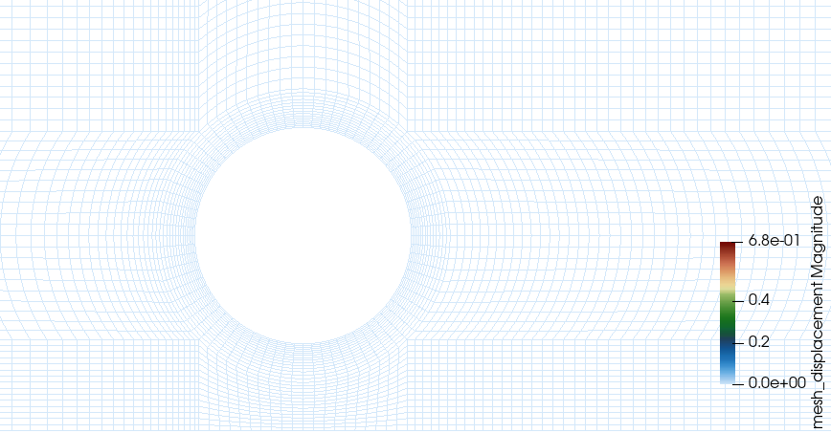
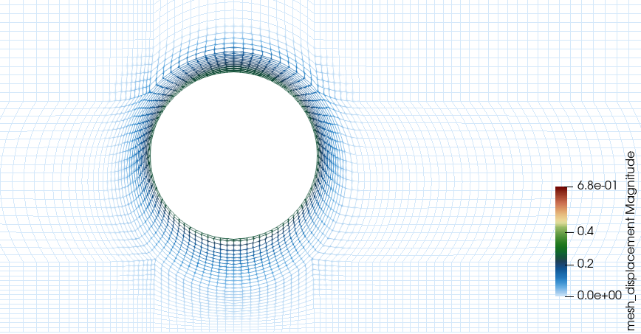
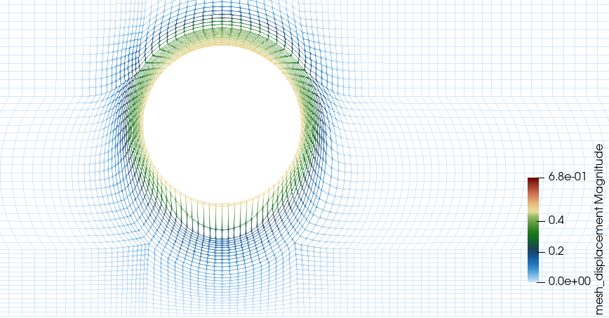
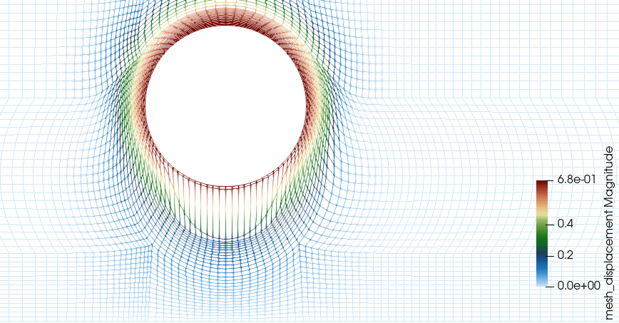
Complexity: Mesh Inversion
In general, there may be a maximum mesh displacement that can not be supported

Slide 13
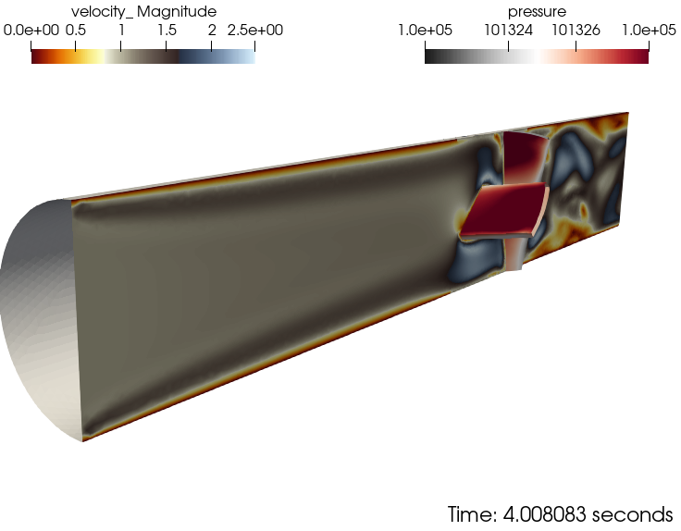

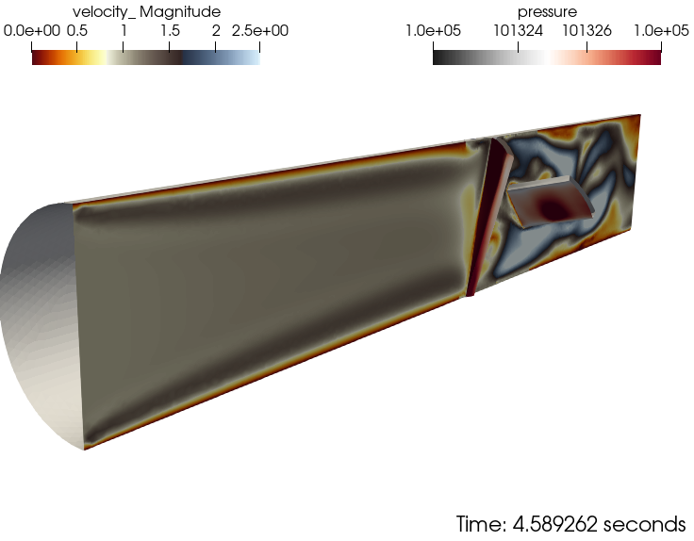

Sliding Mesh: Conceptual Description: Review
A generalized non-conformal scheme supports will fixed rotation
Conceptually, multiple sliding blocks can be included
Below, we note:
Front blade, COUNTER-CLOCKWISE
Back blade, CLOCKWISE

Slide 14
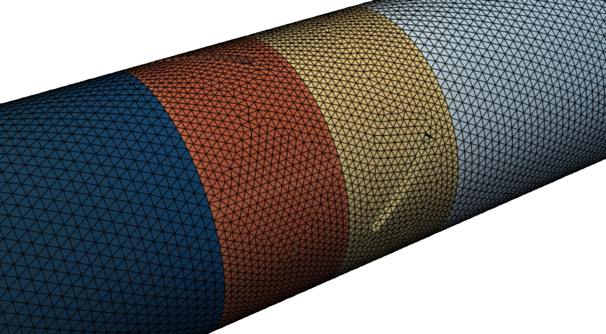
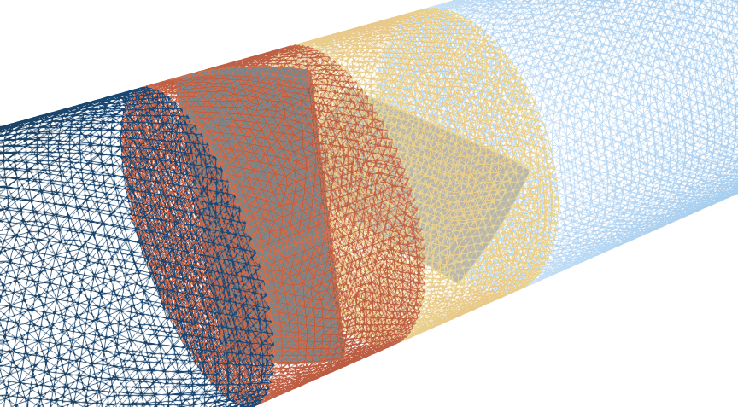
Multiple Sliding Mesh: Geometry

Slide 15
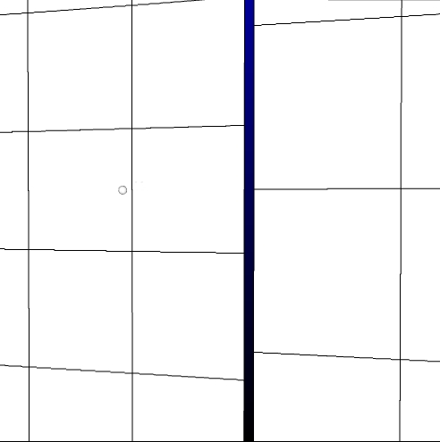
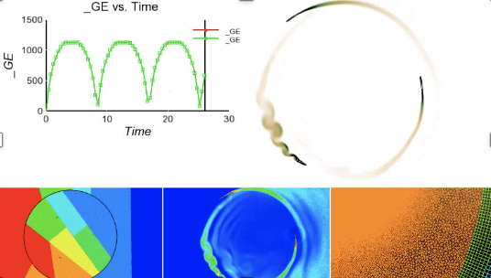
Halo-based Approach for Non-Conformal Interfaces: Vertex-Based
Has the “flavor” of an overset method; i.e., extrusion of surface mesh to opposing domain with reconstruction of states
Two-pass algorithm: surface_1:block_2 and surface_2:block_1
See Stejil, 2008 and extrusion-based of Blades, 2006 and Dodds, 2016
First implemented in Nalu for wind-energy applications, Domino, JCP 2018
Requires prescribed movement, e.g., VAWT

Slide 16
Halo-based Approach for Non-Conformal Interfaces; CC-based
Has the “flavor” of an overset method; i.e., extrusion of surface mesh to opposing domain with reconstruction of states
Two-pass algorithm: surface_1:block_2 and surface_2:block_1
See Stejil, 2008 and extrusion-based of Blades, 2006 and Dodds, 2016
First implemented in Nalu for wind-energy applications, Domino, JCP 2018
Requires prescribed movement

Slide 17
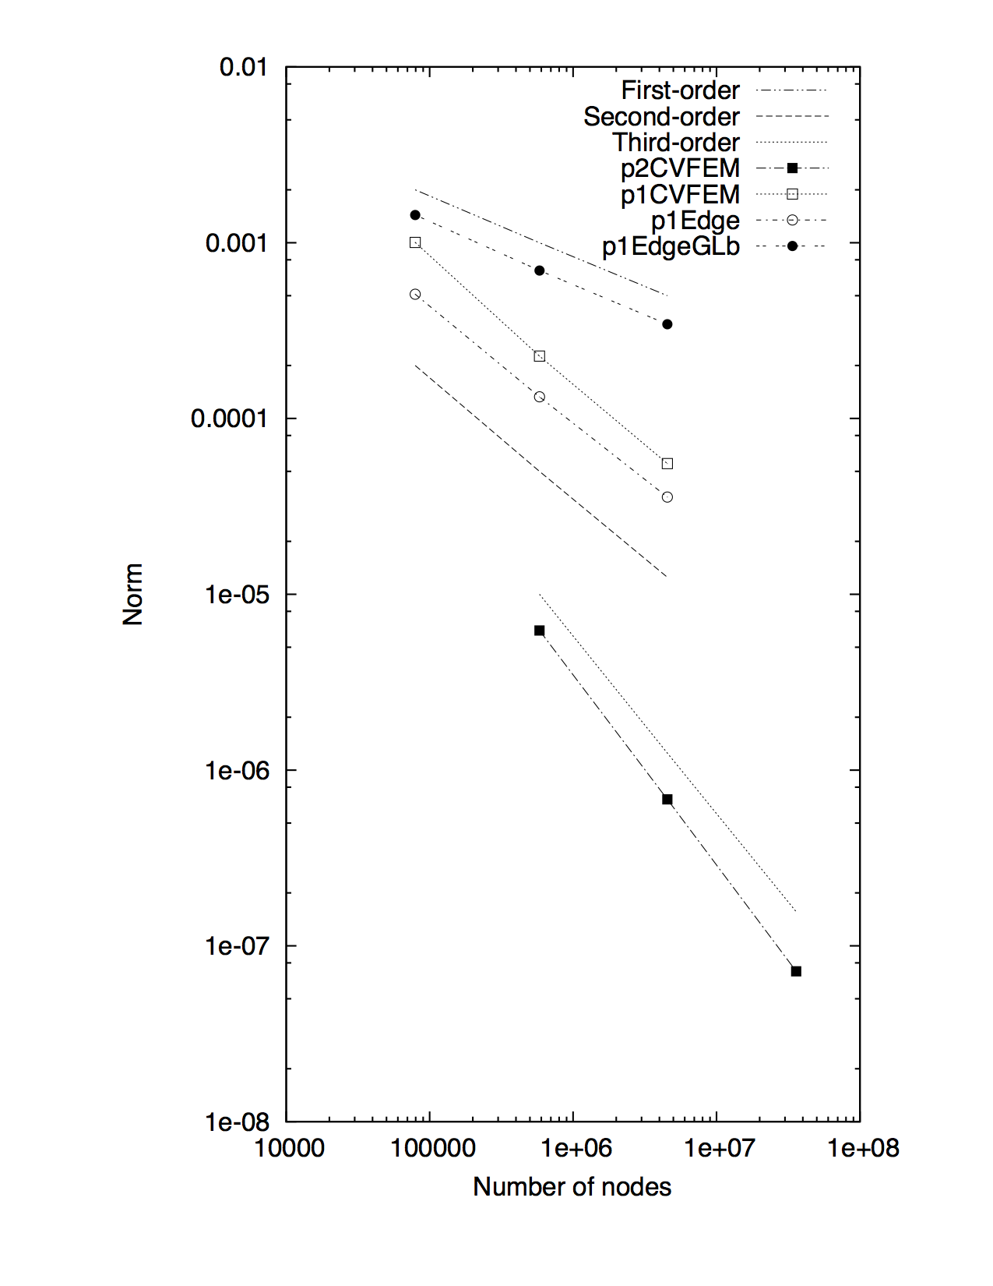
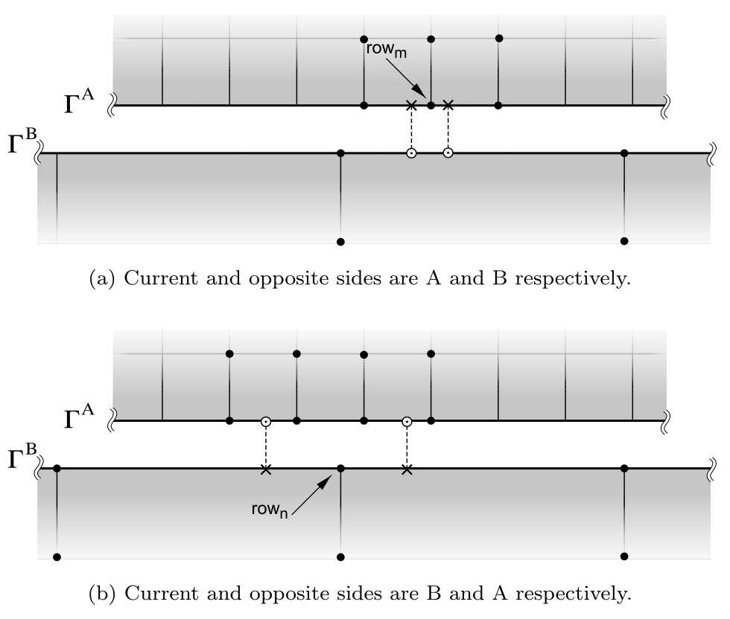
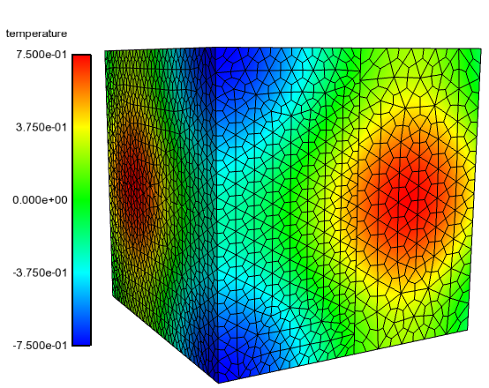
Design-order Mesh Constructs for Non-Conformal Interfaces: Requires Prescribed Mesh Movement
Non-conformal and overset methods provides ease of meshing and, when required, mesh motion
Design-order hybrid DG/CVFEM established, see Domino, J. Comput. Phys. (2018) based on classic discontinuous Galerkin work of Arnold et al. SIAM (2002)
Non-conformal MMS
Current/Opposite

Slide 18
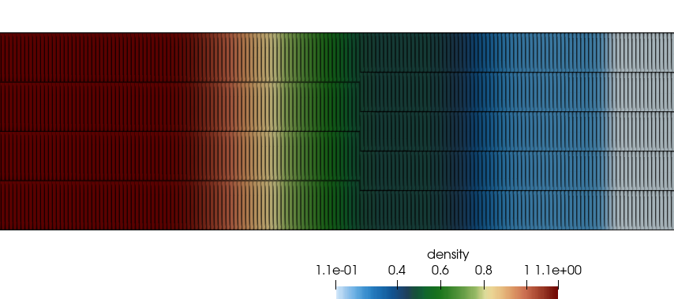
Shock Tube: Non-conformal Mesh
New!
Hybrid DG/CVFEM-based non-conformal algorithm originally developed for the low-Mach regime
Domino, S. P., "Design-order, non-conformal low-Mach fluid algorithms using a hybrid CVFEM/DG approach", J. Comput. Physics, 2018,
https://doi.org/10.1016/j.jcp.2018.01.00
Compressible AUSM regime
Non-conformal (static) interface

Slide 19
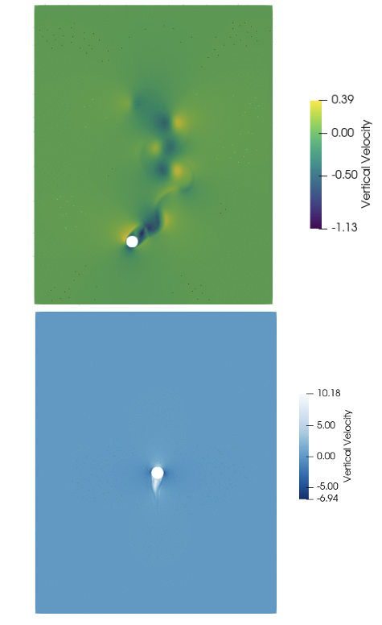
What is there is non-prescribed mesh motion?
In many applications, the movement of the body is coupled to the fluid flow
What then?
Falling/rising sphere of Horne and Mahesh, J.
Comput. Fluids, (2019)
Buoy drop of Ransley et al., Renew. Ener. (2017)

Slide 20
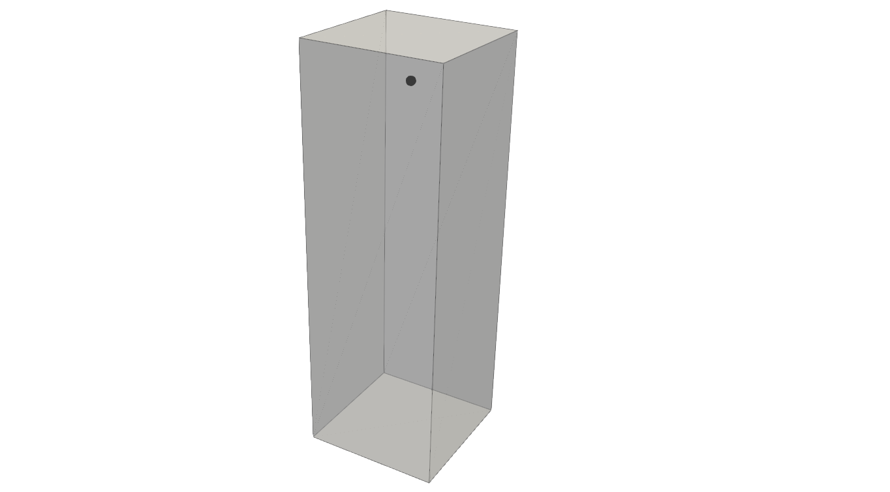
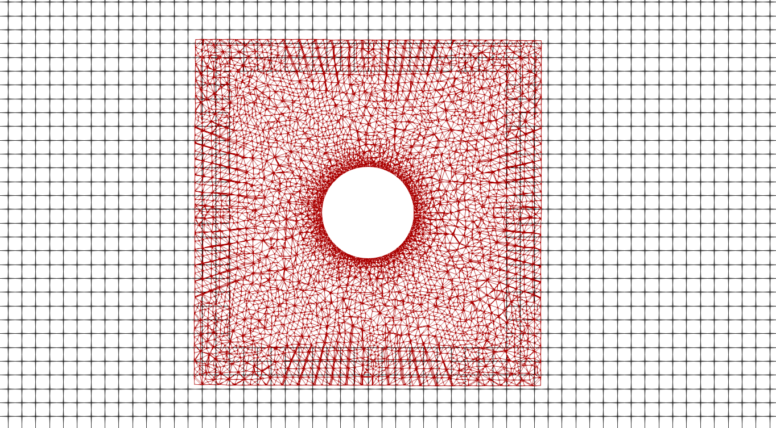
Overset!
Background and overset meshes are defined

Slide 21
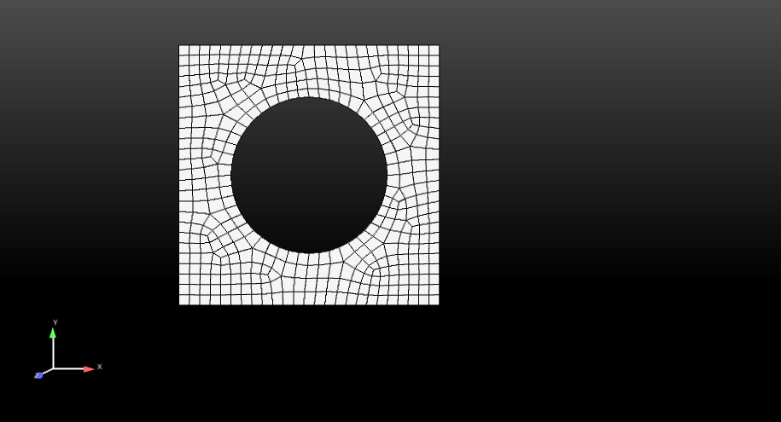
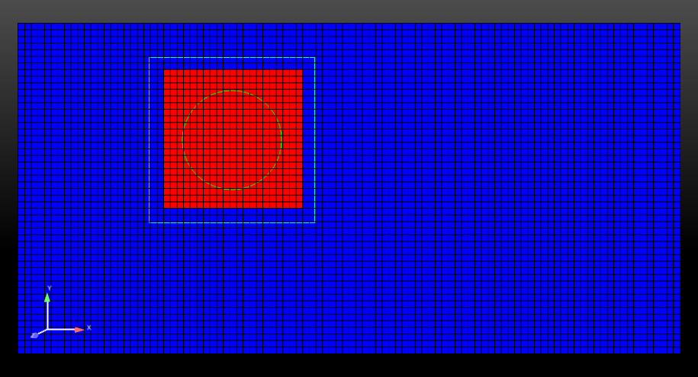
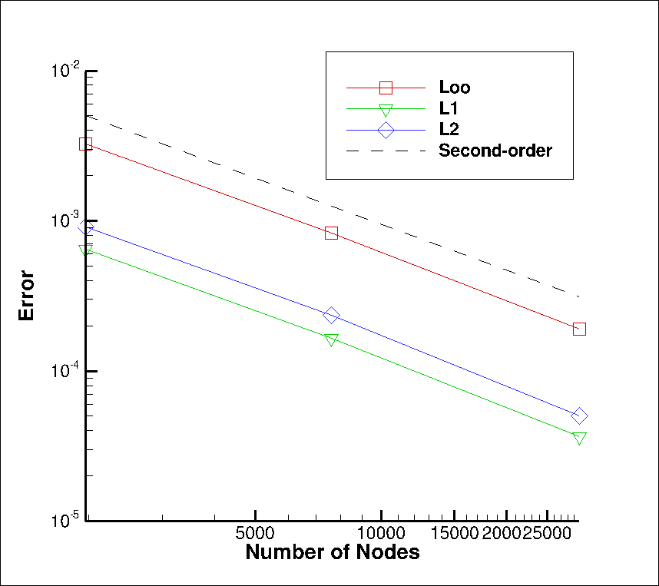
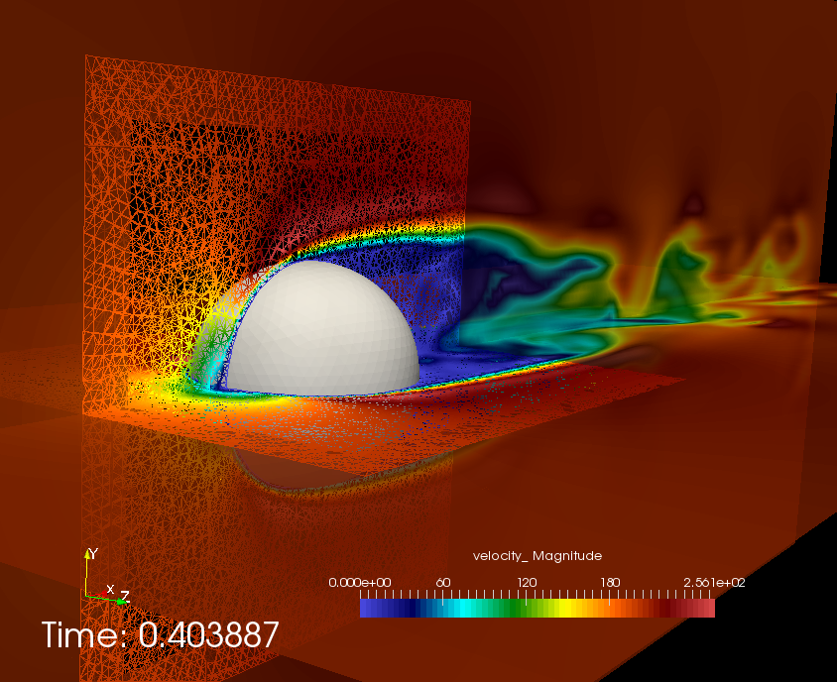
Overset: Freedom for Generalized Motion
Implicit, constraint-based overset-based approach, AKA, Chimera”, Chesshire and Henshaw, J. Comput. Phys. 90 (1990)
Does not require presumed movement
Similar to Sharma et al, J. Comput. Phys. (2021), however, STK-based search
BLOCK_3 (newly declared and
changed part)
Constraint-based
BLOCK_2
BLOCK_1
Surface_1 (read in)
Surface_101 (newly declared and changed part)
Fluids Hex/Tet
MMS

Slide 22
Overset: Freedom for Generalized Motion
Implicit, constraint-based overset-based approach, AKA, Chimera”, Chesshire and Henshaw, J. Comput. Phys. 90 (1990)
Does not require presumed movement
Similar to Sharma et al, J. Comput. Phys. (2021), however, STK-based search
BLOCK_3 (newly declared and
changed part)
Constraint-based
Fringe
BLOCK_2
BLOCK_1
Surface_1 (read in)
Surface_101 (newly declared and changed part)
Fluids Hex/Tet
MMS

Slide 23
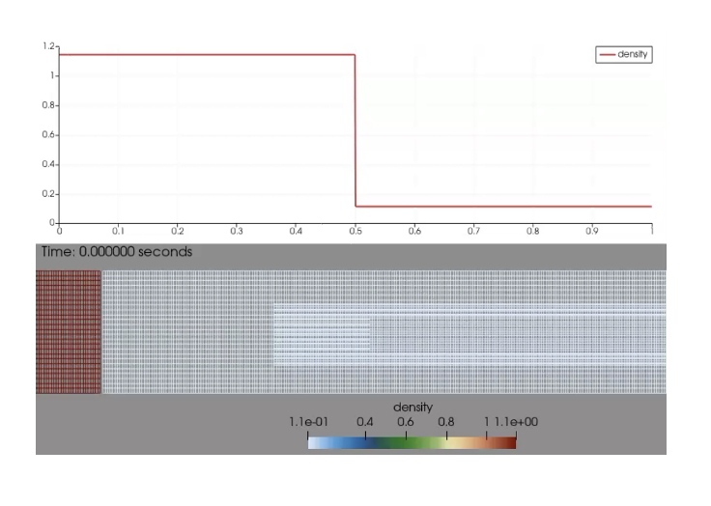
Shock Tube: Overset Mesh
New!
Based on implicit constraint-based approach originally developed for the low-Mach regime
Domino, S. P. and Horne, W., "Development and deployment of a credible unstructured, six-DOF, implicit low-Mach overset high-fidelity simulation tool for wave energy applications”, submitted to Renewable Energy (11/2021)
Extended to compressible regime
Overset (static) interface

Slide 24
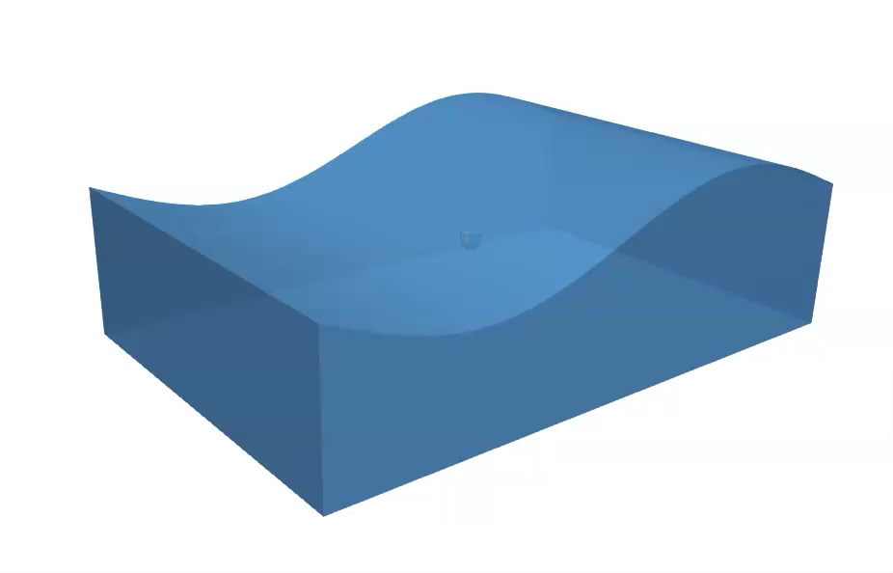
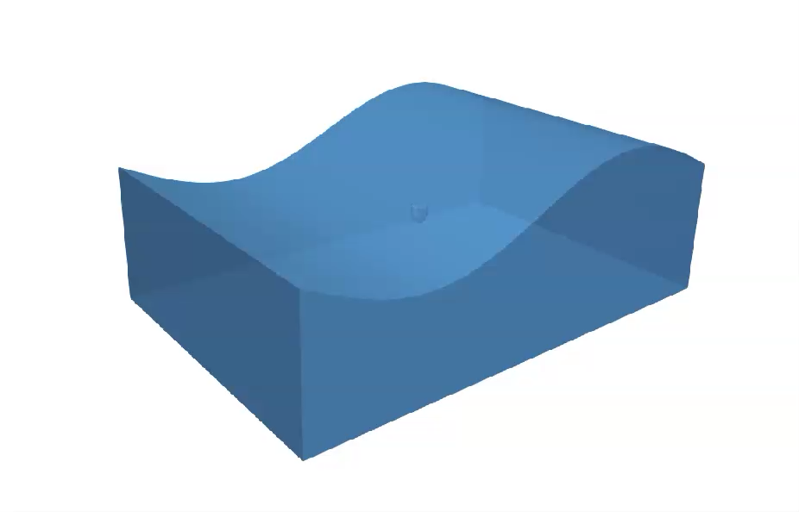
Buoy Subjected to large Wave-Form Validation Benchmark: Explore Center of Mass
High COM
Low COM

Slide 25
Mesh Motion Review
Low-to-Moderate Displacement:
Solid mechanics analogies, either PDE or physical (springs)
Added GCL requirements, matrix is constant
Prescribed Mesh Motion via sliding:
Halo, or DG-based
No added GCL, however, matrix changes (along well-defined surfaces)
Full six-DOF motion:
Overset
Everything changes!

